Slide 1
Debre Birhan University
Chapter 1
Advance Programming
Prepared by:-Zerihun T.

Slide 2
Object
Represents an entity in the real world that can be distinctly identified to be represented into the software application
An Object Has:-
State/Properties/Attribute : represents data(value)of an object
Behavior/Method: Represents the actions or functionality that the object can perform.
Identity: A unique identifier that distinguishes one object from another. Example
State/Properties/Attributes: accountNumber ,accountHolderName ,balance
Behavior/Methods: deposit, withdraw, displayBalance():
Identity: accountNumber serves as the unique identifier for the object.

Slide 3

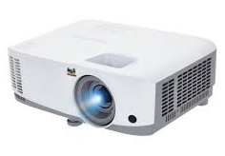

Types Of Object
2.Logical object
Physical Object
Logical objects represent abstract concepts or intangible entities that exist in the logical or conceptual domain. These objects model things that don’t have a physical form but are essential for the system’s functionality.
Physical objects represent tangible, real-world entities that have a physical existence. These objects typically model things you can see, touch, or interact with in the physical world.
Person
Projector
Example:- Back account, student Grade, Course
Laptop

Slide 4
// Define a class
class Car {
// State (attributes) : represents data(value)of an object
String color;
String model;
// Behavior (methods) Represents the actions or functionality that the object can perform.
void start() {
System.out.println("Car is starting...");}
void stop() {
System.out.println("Car is stopping...");}}
// Create an object of the Car class
public class Main {
public static void main(String[] args) {
// Creating an object
Car myCar = new Car(); //The constructor Car() is called to initialize the object's fields.
// Setting state means updating or changing this condition.
myCar.color = "Red";
myCar.model = "Tesla";
// Accessing behavior
myCar.start();
myCar.stop();
}}

Slide 5
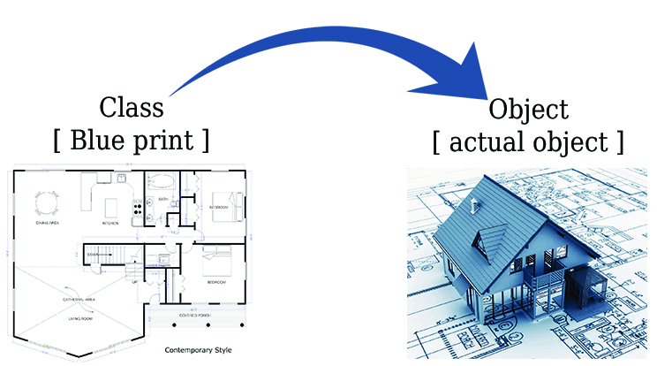
Class
A class is group of objects that has common properties and characterizes
A class is a description, blueprint ,design or template for creating an object
Class is a blueprint for creating objects, and it encapsulates data (attributes) and behavior (methods) into a single unit.
This new datatype can be used to create object
Example Person,Car

Slide 6
Difference Between Classes and Objects
Aspect | Class | Object
Nature | Logical entity (blueprint) | Physical entity (instance)
Memory Allocation | No memory is allocated for a class. | Memory is allocated when an object is created.
Existence | Exists only in code as a definition. | Exists in memory during program execution.
Declaration | A class can only be declared once | Objects can be created many times as per requirement.
Example | Car class defines attributes and methods. | myCar is an object of the Car class

Slide 7
Class Declaration
The syntax for a simple class declaration is
modifiers class class-name
{
body
}
Where the optional modifiers may be one or more of the three keywords {public, abstract, final},
Class-name is any valid identifier, and
Body is a sequence of declarations of variables, constructors, and methods

Slide 8
Class Modifiers
Modifier | Description | Example
public | The class is accessible from anywhere. | public class MyClass {}
default | The class is accessible only within the same package. | class MyClass {}
final | The class cannot be subclassed. | final class MyFinalClass {}
abstract | The class cannot be instantiated and may contain abstract methods. | abstract class MyAbstractClass {}

Slide 9
What Is Methods
Class hugeStatemnet{
public static void main(String[] rgs){ args
Statement 1;
Statement 2;
Statement 3;
Statement 4;
Statement 5;
Statement 6;
Statement 7;
Statement 8;
Statement 9;
Statement 10;
.
.
Statement 1000;
}}
How we will manages huge statements
How to create a code
-reusable
-easily managed

Slide 10
What Is Methods
Method is a block of code that performs a specific task or operation.
It is defined within a class and its functionality.
A large program can be divided into the basic building blocs known as method/function
A method contain the set of statements { }
A method must be declared within in the class
For Example If we have a class then this class should have like eating(),waking(),talking() etc, which describes the behavior of object
The main method:- public static void main(String[] a rgs){ } Program execution starts from main function

Slide 11
Syntax of a Method in Java:
access_modifier return_type method_name(parameter_list) {
// Method body (code to be executed
return value; // Optional, depending on the return type) }
Components of a Method:
Access Modifier: Defines the visibility of the method (e.g., public, private, protected, or default).
Return Type: Specifies the type of value the method returns. Use void if the method does not return any value.
Method Name: The name of the method, following Java naming conventions .
Parameter List: A comma-separated list of input parameters (if any) enclosed in parentheses ().
Method Body: The block of code that defines what the method does.
Return Statement (Optional) – Returns a value if the return type is not void.).

Slide 12
Types of Methods in Java
Predefined Methods (Built-in Methods) – Methods provided by Java (e.g., Math.sqrt(), System.out.println()).
User-defined Methods – Methods created by the programmer.
Static Methods – Methods that belong to a class and do not require an object to be called.
Instance Methods – Methods that require an object of the class to be invoked.
Parameterized Methods – Methods that take input parameters.
Non-Parameterized Methods – Methods that do not take parameters.
Return Type Methods – Methods that return a value.
Void Methods – Methods that do not return a value.
Method calling Syntax -method_name(v1,v2…);
arguments
Example subtraction (8,8);
An argument is a value that is passed to a method when it is called

Slide 13
Example of a Method in Java
public class Calculator {
// Method to add two numbers
public int add(int a, int b) {
return a + b; }
// Method with no return value (void)
public void displayMessage() {
System.out.println("Hello, this is a method!");}
public static void main(String[] args) {
// Creating an object
Calculator calc = new Calculator();
// Calling the add method
int result = calc.add(5, 3);
System.out.println("Sum: " + result);
// Calling the displayMessage method
calc.displayMessage(); } }

Slide 14
Example 1: Basic User-Defined Method
public class Example {
void sayHello() {
// User-defined method
System.out.println("Hello, welcome to Java!");
} // User-defined method
public static void main(String[] args) {
Example obj = new Example(); // Creating an object
obj.sayHello(); // Calling the method
}
}
Output Hello, welcome to Java!

Slide 15
Example 2: Method with Parameters
Syntax ---method name (datatype1 par1,datatyep2 par2…)
Parameters: Allow you to pass data to a method so it can perform operations using that data.
Arguments: The actual values passed to the method when it is called Arguments.
Information van be pass to a method as parameter
Parameter act as variable inside the method
You can use single or multiple parameter
public class Calculator {
// Method with parameters
int add(int a, int b) {
return a + b;
}
public static void main(String[] args) {
Calculator calc = new Calculator();
int result = calc.add(5, 7); // Calling method with arguments
System.out.println("Sum: " + result); }}
Output Sum: 12

Slide 16
Example 3: Static Method
Static Methods: Belong to the class itself and can be called without creating an object.
public class StaticExample {
// Static method
static void displayMessage() {
System.out.println("This is a static method.");
}
public static void main(String[] args) {
displayMessage(); // No need to create an object
}
}
Output This is a static method.

Slide 17
Example 4: Method Returning a Value
used when you want the method to perform a computation or operation and provide a result back to the caller. This is particularly useful when the method's output is needed for further processing or decision-making in the program.
public class SumCalculator {
// Method to calculate the sum of two numbers
public int calculateSum(int num1, int num2) {
return num1 + num2; // Returns the sum
}
public static void main(String[] args) {
SumCalculator calculator = new SumCalculator();
// Calling the method and storing the returned value
int result = calculator.calculateSum(10, 20);
System.out.println("Sum: " + result);
// Using the returned value in an expression
int total = result + 50;
System.out.println("Total after adding 50: " + total);}}

Slide 18
Common Uses of the Dot Operator in Java:
1.Accessing Instance Variables(Fields):
The dot operator is used to access the fields (instance variables) of an object
class Person {
String name;
int age;
}
public class Main {
public static void main(String[] args) {
Person person = new Person();
person.name = "John"; // Accessing the 'name' field using the dot operator
person.age = 30; // Accessing the 'age' field using the dot operator
System.out.println(person.name + " is " + person.age + " years old.");
}
}
Output:- John is 30 years old.

Slide 19
2.Calling Methods of an Object:
class Circle {
double radius;
double getArea() {
return Math.PI * radius * radius;
}
}
public class Main {
public static void main(String[] args) {
Circle c = new Circle();
c.radius = 5.0;
System.out.println("Area: " + c.getArea()); // Using dot operator to call method
}
}

Slide 20
2.Calling Methods
Result: 8
The dot operator is used to call methods on an object. java
class Calculator {
int add(int a, int b) {
return a + b;
}
}
public class Main {
public static void main(String[] args) {
Calculator calc = new Calculator();
int result = calc.add(5, 3); // Calling the 'add' method using the dot operator
System.out.println("Result: " + result);
}
}
Output: Result: 8

Slide 21
3. Accessing Static Members
The dot operator is also used to access static fields and methods of a class. Static members belong to the class itself rather than an instance of the class.
class MathUtils {
static final double PI = 3.14159;
static double square(double x) {
return x * x;
}
}
public class Main {
public static void main(String[] args) {
double piValue = MathUtils.PI; // Accessing the static field 'PI'
double squaredValue = MathUtils.square(4); // Calling the static method 'square'
System.out.println("PI: " + piValue);
System.out.println("Square of 4: " + squaredValue);
}
}

Slide 22
Creating A Class
Example:- Circle
Data Fields(attributes)
-center : Point
-radius : double
Methods(actions)
-getArea() : double
-getPerimeter() : double
-setRadius( newRadius : double ) : Void
-setCenter( newCenter : double ) : Void
Outline
Defining Class
Defining Attribute
Defining Methods

Slide 23
Defining the Class Circle Class
class Circle{
}
Defining the Attribute
class Circle{
Point center ;
Double radius;
}
,attribute/instance Variable
-Declared directly inside the class
-Can be accessed any where inside the class, inside all method
-Take defaults values (center is null and` radius is 0.0)
-Each object we created will have a center and a radius

Slide 24
Defining the methods
class Circle{
// Attributes (fields or instance variables)
Point center ;
double radius;
// Method to calculate circumference
double getPerimeter(){
return 2*Math.PI*radius } //Circumference=2πr²
// Method to calculate the area of the circle
double getArea(){ // Area = πr²
return 2*Math.PI*radius }
V
Math is build in java class

Slide 25
// Method to set the radius
void setRadiuos (dobule newRadius){
radius= newRadius }
// Method to set the center
void setCenter(Point newCenter){
Center=newCenter
}

Slide 26
Instance Fields
Instance fields (also called instance variables) are variables declared inside a class but outside of any method, constructor, or block. Each instance (object) of the class has its own copy of these fields.
Instance Fields vs. Static Fields
Feature | Instance Fields | Static Fields (static)
Belongs to | Object (Instance) | Class
Memory | Each object has its own | Shared among all objects
Access | objectName.fieldName | ClassName.fieldName
Lifecycle | Created when object is created, destroyed when object is garbage collected | Exists as long as the class is loaded
class Example {
int instanceVar = 10; // Instance field
static int staticVar = 20; // Static field

Slide 27
Comparing and Identifying Objects in Java
1.Reference Comparison (== operator)
The = = operator compares object references (memory addresses), not the content of objects.
String a = newString("hello")
String b = newString("hello");
String c = a
System.out.println( a = = b);// false - different objects in memory
System..println(c = = a);// true - c points to the same object as a
2.Value Equality (Content Equality)Content Comparison (.equals() method)
The .equals() method compares the actual content of objects. For custom classes, you need to override it.
String a = new String("hello");
String b = new String("hello");
System.out.println(a.equals(b)); // true - same content

Slide 28
3.Using hashCode() for Object Comparison
The hashCode() method returns an integer representation of an object.
If equals() is overridden, hashCode() should also be overridden to ensure consistency.
Rule: If obj1.equals(obj2) == true, then obj1.hashCode() == obj2.hashCode() should also be true.
Summary
Method | Purpose
= = | Checks reference equality (same memory location)
.equals() | Checks value/content equality (must be overridden in custom classes)
hashCode() | Generates a hash for an object; should be consistent with equals()
instanceof | Checks if an object is an instance of a specific class or subclass
getClass() | Checks if two objects belong to the exact same class

Slide 29
Destroying Objects
In Java, objects are not explicitly destroyed by the programmer. Instead, the Java Garbage Collector (GC) automatically manages memory by reclaiming the memory occupied by objects that are no longer in use. This process is known as garbage collection.
Every objects uses recourse such as memory
Object Lifecycle in Java
Creation: Objects are created using the new keyword.
Usage: Objects are used in the program.
Unreferenced: When an object is no longer referenced by any variable, it becomes eligible for garbage collection(i.e local variable ).
Destruction: The garbage collector reclaims the memory occupied by unreferenced objects.

Slide 30
1. Garbage Collection in Java
Example 1: Nullifying References
class Example {
String name;
Example(String name) {
this.name = name;
public static void main(String[] args) {
Example obj = new Example("Hello");
obj = null; // Object is now eligible for GC
}}
Example 2: Reassigning References
classExample { publicstaticvoidmain(String[] args) { Exampleobj1=newExample(); Exampleobj2=newExample(); obj1 = obj2; // First object loses reference, eligible for GC }}
Example 3: Objects Inside MethodsObjects created inside a method become unreachable once the method finishes execution
class Example { void createObject() { Example temp=newExample(); // temp is local to this method } // temp is eligible for GC after this method ends public static void main(String[] args) { Example obj=new Example(); obj.createObject();}}

Slide 31
Summary
Method | Purpose | Reliability
Nullifying references | Makes objects eligible for GC | ✅ Reliable
Reassigning references | Makes previous object unreachable | ✅ Reliable
Objects inside methods | Objects become unreachable after method execution | ✅ Reliable
System.gc() | Requests GC, but not guaranteed | ⚠️ Not Guaranteed
finalize() | Runs before object is destroyed (Deprecated) | ❌ Unreliable
Weak References | Allows GC to collect object when memory is needed | ✅ Useful for caching
Try-with-resources | Automatically closes resources | ✅ Best practice

Slide 32
Enumerated types (enums)Reading Ass
in Java are a special data type that allows you to define a set of named constants.
Each enum declaration declares an enum class with the following restriction
An enum is defined using the enum keyword. Each constant is separated by a comma and is typically written in uppercase
Top-Level Enum: Declared in its own
public enum
Day { SUNDAY, MONDAY, TUESDAY, WEDNESDAY, THURSDAY, FRIDAY, SATURDAY}
Nested Enum: Declared inside a class.
public class Week
{ enum Day { SUNDAY, MONDAY, TUESDAY, WEDNESDAY, THURSDAY, FRIDAY, SATURDAY } }
Static Nested Enum: Declared as a static member of a class
public class Week {
public static enum Day { SUNDAY, MONDAY, TUESDAY, WEDNESDAY, THURSDAY, FRIDAY, SATURDAY } }

Slide 33
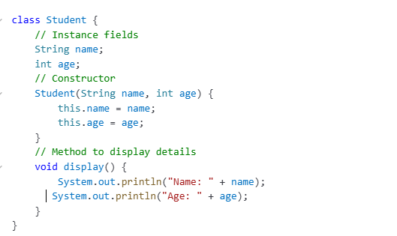
Example of Instance Fields

Slide 34
Constructors
A constructor in Java is a special method used to initialize objects of a class.
It is automatically called when an object is created and is primarily used to set initial values for object attributes.
Key Characteristics:
Has the same name as the class.
Does not have a return type (not even void).
Can be overloaded (multiple constructors in a class).
Automatically executes when an object is instantiated
Importance:
Ensures that objects are properly initialized when created.
Reduces the risk of errors by enforcing required initial values.
Allows flexibility in object creation through constructor overloading.

Slide 35
Types of Constructors in Java
Java provides three types of constructors:
a) Default Constructor (No-Argument Constructor)
A constructor without parameters that initializes objects with default values.
class Car {
String model;
// Default Constructor
Car() {
model = "Unknown Model" }
void display() {
System.out.println("Car Model: " + model);}
public static void main(String[] args) {
Car myCar = new Car(); // Calls the default constructor
myCar.display();
}}
Output:Car Model: Unknown Model

Slide 36
b) Parameterized Constructor
A constructor that takes arguments to initialize an object with specific values.
class Car {
String model;
// Parameterized Constructor
Car(String modelName) {
model = modelName; }
void display() {
System.out.println("Car Model: " + model);
}
public static void main(String[] args) {
Car myCar = new Car("Toyota"); // Calls the parameterized constructor
myCar.display();
}}
When to use? When different objects need different values during initialization.
Output:
Car Model: Toyota

Slide 37
c) Copy Constructor (User-Defined in Java)
Java does not provide a built-in copy constructor, but we can create one manually. It initializes a new object by copying values from another object.
class Car {
String model;
// Parameterized Constructor
Car(String modelName) {
model = modelName; }
// Copy Constructor
Car(Car oldCar) {
this.model = oldCar.model; }
void display() {
System.out.println("Car Model: " + model);
}public static void main(String[] args) {
Car car1 = new Car("Ford");
Car car2 = new Car(car1); // Calls the copy constructor
car2.display();
Output
Car Model: Ford

Slide 38
Importance of Constructors in Java
✅ Automatic Object Initialization: Eliminates the need to manually assign values after object creation. ✅ Encapsulation & Abstraction: Hides the initialization logic from the user. ✅ Code Reusability: Helps avoid redundant code by initializing objects in one place. ✅ Supports Overloading: Multiple constructors allow flexibility in object creation. ✅ Ensures Object Integrity: Prevents uninitialized objects by forcing default or specific values at the time of creation.

Slide 39
Access Modifiers
Access modifiers in Java define the visibility and accessibility of classes, methods, and variables. They control which parts of the program can access a particular piece of code.
Modifier | Same Class | Same Package | Subclass (Different Package) | Other Classes (Different Package)
public | ✅ Yes | ✅ Yes | ✅ Yes | ✅ Yes
protected | ✅ Yes | ✅ Yes | ✅ Yes | ❌ No
default (No modifier) | ✅ Yes | ✅ Yes | ❌ No | ❌ No
private | ✅ Yes | ❌ No | ❌ No | ❌ No

Slide 40
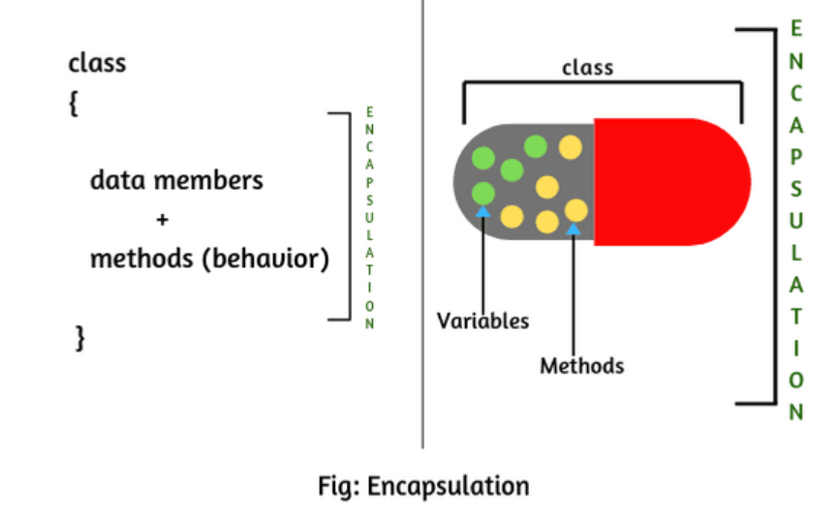
Encapsulation
Encapsulation It refers to the concept of bundling the data (variables) and methods (functions) that operate on the data into a single unit or class. It also hides the internal details of the object and only exposes the necessary functionality to the outside world.
In simple terms, encapsulation is the process of restricting direct access to some of the object's components and protecting the object's state by making variables private and providing public methods to access and update them.

Slide 41
Encapsulation is typically implemented in Java:
Private Variables: The data members of a class are declared private. This means they cannot be accessed directly from outside the class.
Public Methods: Public methods, often called getters and setters, are provided to access and modify the private data members. These methods can include validation or other logic to ensure the integrity of the data.

Slide 42
The End

